Slide 1

LECTURE one
THEORY OF COMPUTING ccs 3113

Slide 2

Short Answer submissions (1/3)
Name | Response
C026-01-0787/2023 | To learn
C026-01-0786/2023 | To learn about theory of computation
Lenson | Learn a new unit on theory of computing
C026-01-0772/2023 | To gain insight on the course
Elisha | To get the introduction and Objectives of the unit
C026-01-0733/2023 | To learn about theory of computing
C026-01-0765/2023 | To get an insight on what the unit is about

Slide 3
Short Answer submissions (2/3)
Name | Response
C026-01-0774/2023 | To get skills and insight and what unit is about
C026-01-0713/2023 | Curious about Theory of Computation
CO26-01-2114/2023 | To gain basics of Theory of Computing.
c026-01-0736/2023 | To learn
C026-01-0936/2022 | To learn more about the theory of computing and it's field
C026-01-0714/2023 | My objective is to learn more on the more theoretical part of computing and all related concepts.
C026-01-1533/2023 | I like to pass and gain skills which I can apply

Slide 4
Short Answer submissions (3/3)
Name | Response
C026-01-0732/2023 | To know what the unit entails

Slide 5
Course outline
Purpose of the course
To enable the learners to apply the concepts, theories and models in the theory of computation.
Expected Learning Outcomes of the Course
By the end of the course, the learner should be able to:
Explain the concepts and principles of computability and complexity theories.
Apply the relevance of theory of computation in solving problems.
Design a simple Turing Machine.

Slide 6
Course contents
Introduction Mathematical preliminaries
Automata theory
Regular languages, Deterministic and non-deterministic machines,
Context-Free Grammars, Parse Trees; Ambiguity in Grammars and Languages,
Standard Forms, Chomsky Normal Forms, Computability theory;
Turing machines, Programming Techniques for Turing Machines, Formal definition of TM’s, TM’s as acceptors,TM’s as transducers, Recognizing Languages with TM’s, Sorting with TM’s, Programming in TM’s,
Computation theory
Church-Turing thesis, decidability, halting problem, reducibility, recursion theorem,
Complexity Theory;
Time and space measures, hierarchy theorems, complexity classes P, NP, L, NL, PSPACE, BPP and IP, complete problems, P versus NP conjecture, quantiers and games,
provably hard problems, relativized computation and oracles, probabilistic computation,
interactive proof systems.

Slide 7
Practical
For all automata theory practical's we shall use JFLAP
Available at https://www.jflap.org/jflaptmp/
For grammar we shall use NLTK: The Natural Language Toolkit
Available at https://www.nltk.org/
Model the same in Xeror finite state tool
How to use it https://user.phil-fak.uni-duesseldorf.de/~zinova/teaching/CompMorphBlockWiSe2016/xfst.pdf

Slide 8
Introduction
Theory of computing tries to answer
What are the mathematical properties of computer hardware and software?
What is a computation and what is an algorithm?
Can we give rigorous mathematical definitions of these notions?
What are the limitations of computers? Can “everything” be computed?
Purpose of the Theory of Computation:
Develop formal mathematical models of computation that reflect real-world computer
What are the fundamental capabilities and limitation of computers

Slide 9

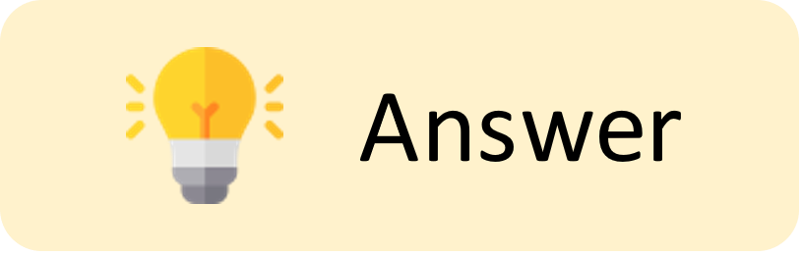

Which of the following best describes the primary focus of the Theory of Computation?
To develop software applications that can perform tasks. To analyze the graphical user interface of computers. To understand the mathematical properties of computation. To evaluate hardware designs for efficiency.
Correct answer: C

Slide 10

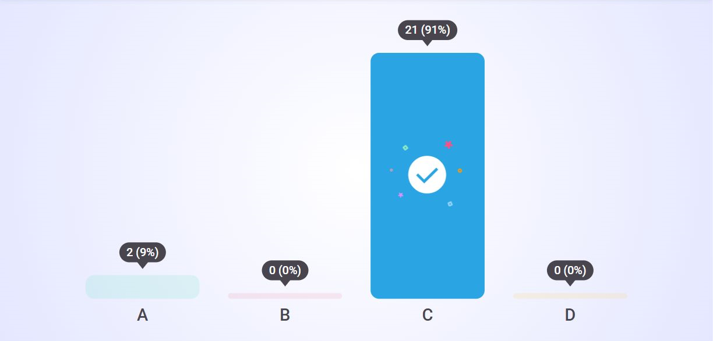
Multiple Choice submissions

Slide 11
Introduction
Started with mathematician logicians
The theory of computing has three branches
Automata theory
Complexity theory
Computation theory

Slide 12
Introduction
Complexity theory
What makes some problems hard or easy
Easy – means efficiently solvable
Sorting a sequence of, say, 1,000,000 numbers
searching for a name in a telephone director
computing the fastest way to drive from Nairobi to Nyeri
Hard – not efficiently solvable
time table scheduling for all courses at MMU
factoring a 300-digit integer into its prime factors
computing a layout for chips in VLSI.
Central Question in Complexity Theory:
Classify problems according to their degree of “difficulty”.
Give a rigorous proof that problems that seem to be “hard” are really “hard”.

Slide 13
Complexity
Confronting complex problems
Understanding the hard part of the problem for altering
Settle for less perfect solutions like approximations
Some problem are only hard in worst case scenarios
Consider alternative solution like randomized

Slide 14
Introduction
Computability theory
some fundamental problems that cannot be solved by a computer and other solvable
To solve a problem needs to formal notion of
Computer
Algorithm
Computation
Central Question in Computability Theory:
Classify problems as being solvable or unsolvable

Slide 15
Which of the following is a fundamental aspect of computability theory?
The development of new programming languages Classifying problems as solvable or unsolvable Creating user-friendly software applications Enhancing computer hardware capabilities
Correct answer: B

Slide 16
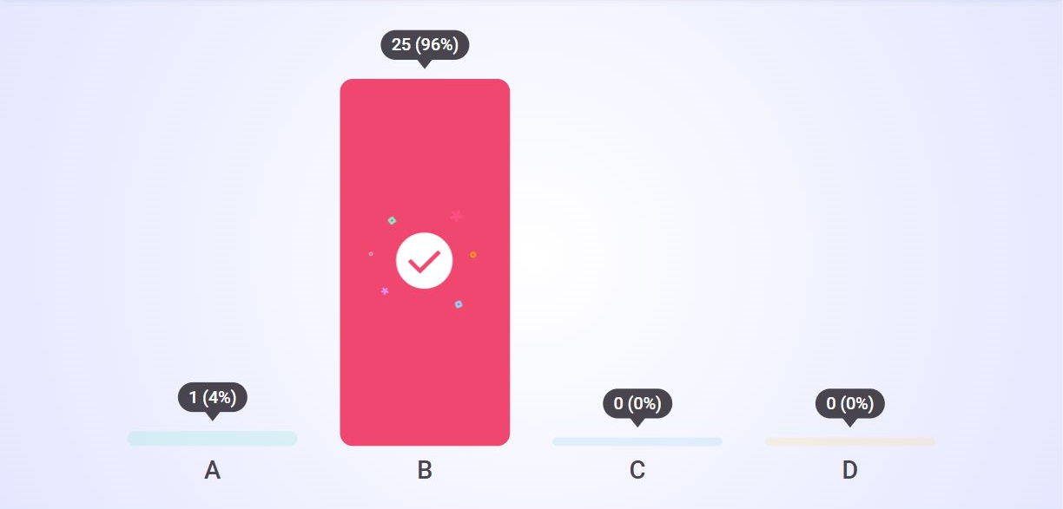
Multiple Choice submissions

Slide 17
Introduction
Automata Theory
Deal with a computational model
Properties and definition
Finite Automata.
These are used in text processing, compilers, and hardware design.
Context-Free Grammar.
These are used to define programming languages and in Artificial Intelligence.
Turing Machines.
These form a simple abstract model of a “real” computer, such as your PC at home.
Central Question in Automata Theory:
Do these models have the same power, or can one model solve more problems than the other?

Slide 18
introduction
What to expect in this course
About the fundamental capabilities and limitations of computers which are core topics of computer science.
About mathematical properties of computer hardware and software.
The theory is very much relevant to practice, for example, in the design of new programming languages, compilers, string searching, pattern matching, computer security, artificial intelligence, etc., etc.
This course helps you to learn problem-solving skills. Theory teaches you how to think, prove, argue, solve problems, express, and abstract.
This theory simplifies complex computers to an abstract and simple mathematical model, and helps you to understand them better.
This course is about rigorously analyzing capabilities and limitations of systems.

Slide 19
Discrete mathematics
Mathematics preliminaries
Sets
Functions
Graph
proofs

Slide 20
Sets
Elements of a set: (physical) objects
Set: never physical
a ∈ S
Members of sets may be sets
S = {0, 1, {0, 1}}
Cardinality: card(S) = 3 (number of elements in a set)
Singleton: S = {a} ( with one element)
Sets ≠ lists (unordered, elements are unique)
Set = family = class

Slide 21
Naming Sets
Finite sets {a,e,i,o,u}
Infinite sets: mathematics
enumerate elements in an extended sense
Natural numbers N = {0,1,2,…}
Integers Z = {…,-2,-1,0,1,2,…}
Set abstraction
{n|n is prime} or {n:n is prime}
{n|…n…} or {n:…n…}: abstraction operator: the set of all n such that n
{n|n ∈ N & 2|n}: all even natural numbers

Slide 22
Naming Sets
Use variables n,m,k,j,…: natural numbers / integers
Use variables x,y,z,…: rational/real numbers
Set variables: uppercase letters (A,B,C)
Universal set: U
U by set abstraction {x|x=x}
Empty Set: ∅
∅ by set abstraction {x|x≠x}

Slide 23
Subsets
A = {0,1,2,3,4} A is subset of N or A⊆N
A is a subset of B
For any x, x ∈ A implies x ∈ B
Consequences:
Every set is a subset of itself
∅ ⊆ A, for any set A
“proper subset”: non-identical subset( not identical)
{1,2,3} ⊂ {1,2,3,4}

Slide 24
Power sets
P(S): power of set S
the set that contains all subsets of a given set.
Set of all subsets of S
P(S) = {A|A ⊆ S}
e.g. S = {1,2,3}
P(S) = {∅,{1},{2},{3},{1,2},{1,3},{2,3},{1,2,3}}
Unary set-forming operation
For any finite set S, we have card(P(S)) = 2^{card(S)}

Slide 25
Set forming
Binary set-forming operations
Union of A and B: A ∪ B
two sets X and Y is equal to the set of elements that are present in both the sets X and Y
Intersection of A and B: A ∩ B
{x|x ∈ A and x ∈ B}
Complement of B relative to A
Set U = {2, 4, 6, 8, 10, 12} and set A = {4, 6, 8}, then the complement of set A, A′ = {2, 10, 12}.
Symmetric Difference of A and B: A ⊕ B
the set of elements that are in either set, but not in the intersection.
Compliment-set that contains the elements present in the universal set but not in set A.

Slide 26
Some laws/ de morgans laws
S ∪ S^{c} = U
S ∩ S^{c} = ∅
(S^{c})^{c} = S
A ∪ B = B ∪ A
A ∩ B = B ∩ A
(A ∪ B) ∪ C = A ∪ (B ∪ C)
(A ∩ B) ∩ C = A ∩ (B ∩ C)
A ∪ (B ∩ C) = (A ∪ B) ∩ (A ∪ C)
A ∩ (B ∪ C) = (A ∩ B) ∪ (A ∩ C)
(A ∩ B)^{c} = A^{c} ∪ B^{c}
(A ∪ B)^{c} = A^{c} ∩ B^{c}

Slide 27
Tuples
a finite ordered list of elements
An n-tuple is a tuple of n elements, where n is a non-negative integer.
There is only one 0-tuple, called the empty tuple. A 1-tuple and a 2-tuple are commonly called respectively a singleton and an ordered pair.
Ordered pair: <a,b> = <c,d> iff a = c and b = d
Cartesian product of sets A and B: A x B
A cross B
Set of all ordered pairs whose first element comes from A and whose second element comes from B
A x B = {<a,b>| a ∈ A and b ∈ B}
the set of all ordered pairs (x, y) such that x belongs to A and y belongs to B. For example, if A = {1, 2} and B = {3, 4, 5}, then the Cartesian Product of A and B is {(1, 3), (1, 4), (1, 5), (2, 3), (2, 4), (2, 5)}.

Slide 28
Tuples
Ordered triple: <a,b,c> and A x B x C: set of ordered triples
A x B x C: {<a,b,c>|a ∈ A and b ∈ B and c ∈ C}
Find the Cartesian product of three sets A = {a, b}, B = {1, 2} and C = {x, y}.
Solution:
Given, A = {a, b} B = {1, 2} C = {x, y}
The ordered pairs of A × B × C can be formed as given below:
1st pair ⇒ {a, b} × {1, 2} × {x, y} ⇒ (a, 1, x)
2nd pair ⇒ {a, b} × {1, 2} × {x, y} ⇒ (a, 1, y)
3rd pair ⇒ {a, b} × {1, 2} × {x, y} ⇒ (a, 2, x)
4th pair ⇒ {a, b} × {1, 2} × {x, y} ⇒ (a, 2, y)
5th pair ⇒ {a, b} × {1, 2} × {x, y} ⇒ (b, 1, x)
6th pair ⇒ {a, b} × {1, 2} × {x, y} ⇒ (b, 1, y)
7th pair ⇒ {a, b} × {1, 2} × {x, y} ⇒ (b, 2, x)
8th pair ⇒ {a, b} × {1, 2} × {x, y} ⇒ (b, 2, y)
Thus, the ordered pairs of A × B × C can be written as:
A × B × C = {(a, 1, x), (a, 1, y), (a, 2, x), (a, 2, y), (b, 1, x), (b, 1, y), (b, 2, x), (b, 2, y)}
A¹ x A² x A^{k}: set of ordered k-tuples
0-tuple: A⁰ = {<>}
1-tuple: A¹ = <a> and A¹ = A

Slide 29
Permutation
an arrangement of objects in a definite order
Given k-tuple <a₁,a₂,…,a_{k}> we write <a_{i1},a_{i2},…,a_{ik}> for any arbitrary permutation of k-tuple
Subscripts are mutually distinct and each lies between 1 and k
<a₁,a₂,a₃,a₄> = <10,15,20,25>
<a_{i1},a_{i2}, a_{i3},a_{i4}> = <20,10,25,15>
with i1=3 i2=1 i3=4 i4=2

Slide 30
Principle of Extensionality
If A and B possess the same elements then A=B
Principle:
Let A and B be sets. In order to demonstrate that A = B, it is sufficient to show that
(i) every element of A is an element of B – that is A ⊆ B;
(ii) that every element of B is an element of A - that is B ⊆ A

Slide 31
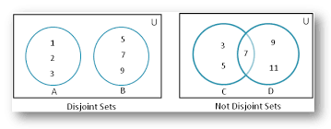
Disjoint sets
Two sets A and B are disjoint if A∩B=∅
Finite family of mutually disjoint sets =
a family of sets A₁,A₂,…,A_{n} with n ≥ 0, such that for any i,j≤n with i≠j we have A_{i}∩A_{j}=∅

Slide 32
Cardinality
Finite sets A and B
card(A∪B) ≤ card(A) + card(B)
card(A∪B) = card(A) + card(B) iff A∩B=∅
Finite family of finite sets: A₁,A₂,…,A_{n}
union of this family: U_{i}A_{i}
card(U_{i}A_{i}) ≤ card(A₁) + card(A₂) + … + card(A_{n})

Slide 33
Partition
Partition of set A: family of mutually disjoint subsets A₁,A₂,…,A_{n} such that A = A₁∪A₂∪…∪A_{n}
N = {n∈N|n is even} ∪ {n ∈ N|n is odd} is a partition of N

Slide 34
Formal language
Formal language: specific kind of set
Formal = not natural language, programming language, …
but: NLP try to formalize natural language
Alphabet Σ: finite set of symbols, e.g. Σ = {a,b}
Word over alphabet Σ: finite string of elements of Σ allowing repetition
Length of word w = |w| = number of symbol occurrences in w
For alphabet Σ= {a,b} we have 2^{n} distinct words over Σ of length n
Card(Σ) = m then there exist m^{n} distinct words over Σ of length n
Special notation: a^{n}b^{m} word consisting of nxa and mxb
a³b⁴a² aaabbbbaa
Distinct occurrences: n_{a}(aba)=2 n_{b}(aba)=1

Slide 35
Formal language
Null word: word of length 0
Zero occurrences of a and b
ε = a⁰
n_{a}(ε) = 0 and n_{b}(ε) = 0
Σ* set of all words over Σ
Language over Σ: any subset of Σ*
Empty language: ∅
Universal language: Σ*
Unit language L = {w}

Slide 36
Operations on words
Catenation/concatenation: ww’ of words w and w’
w is aba and w’ is bba
ww’ = ababba
Reverse of a word: w^{R}
abb^{R} = bba
Palindromes over Σ is the language {w∈Σ*|where w= w^{R})

Slide 37
Operations on words
A word w’ is a prefix of a word w if w can be written w’w’’ for some word w’’
ε,a,ab,abb,abba are prefixes of the word abba (first 4 are proper)
A word w’’ is a suffix of a word w if w can be written w’w’’ for some word w’
ε,a,ba,bba,abba are suffixes of the word abba (first 4 are proper)
A word w’’ is a substring of word w if w can be written as w’w’’w’’’ for some words w’ and w’’
abba: ε a ab bb ba abb bba abba

Slide 38
Formal languages = sets
All of the set-forming operations (union, intersection, …) are valid for languages as well
Binary concatenation operation: .
L₁.L₂ = _{def.} {w₁w₂|w₁ ∈ L₁ & w₂ ∈ L₂}
The language that results from taking a word from L₁ and appending to it a word from L₂

Slide 39
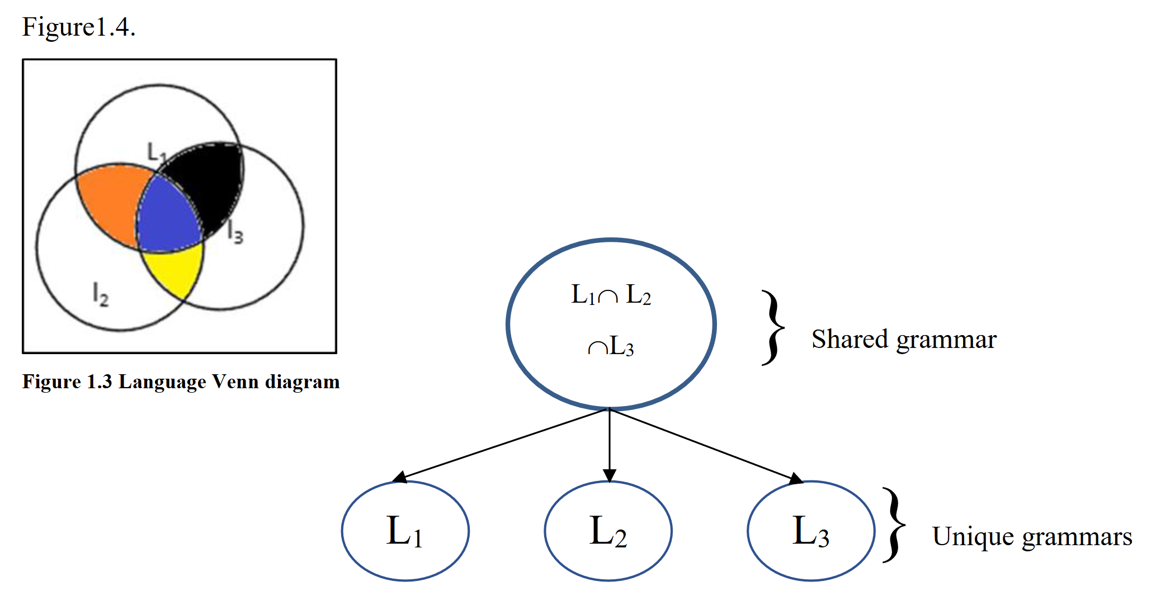
Universal grammar

Slide 40
Kleene-Closure Operator
Symbol *: certain unary operation on languages
Given language L
L* = _{def} {w| for some n ≥ 0, w is the concatenation of n words of L}
L*: is the result of concatenating 0 or more words of L
Also:
L⁺ = _{def} {w| for some n > 0, w is the concatenation of n words of L}
L⁺ ⊆ L*

Slide 41
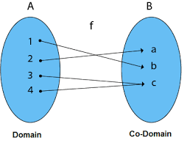
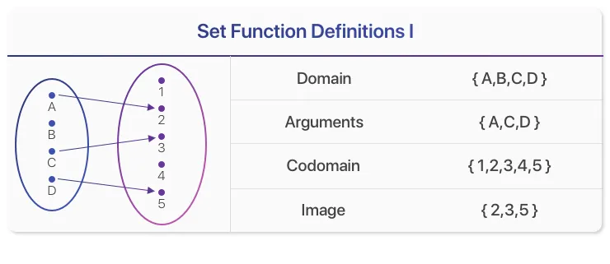
Mapping
Mapping: association of members of one set with members of another set
First: domain
Second: codomain
Members of domain: arguments
Members of codomain: values
Mapping f between Dom(f)=A and Cod(f)=B
f: A → B

Slide 42
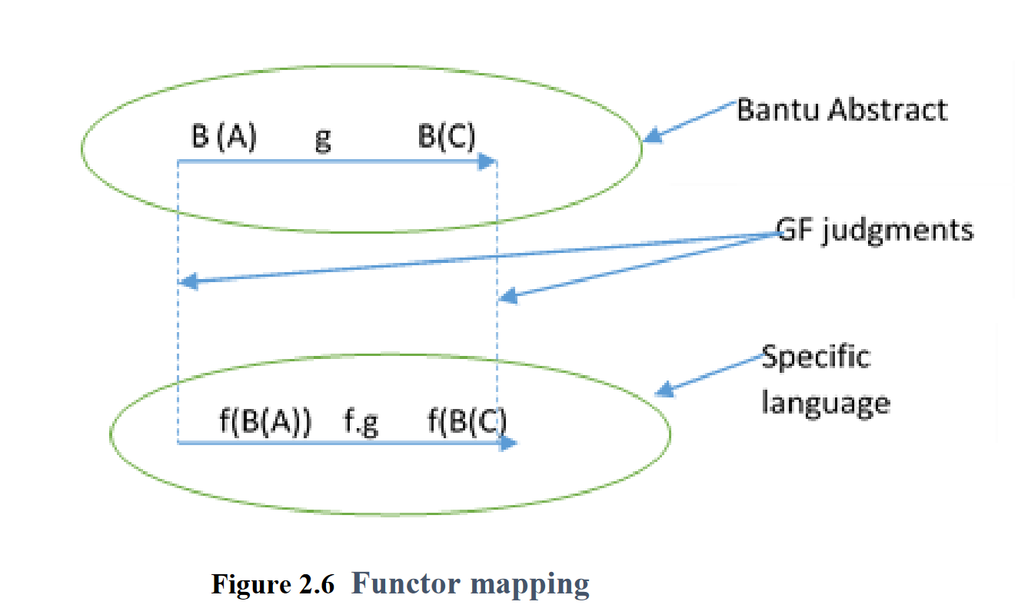
Language mapping

Slide 43
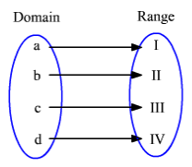
Function
Function = single valued mapping
A mapping f is a function if each member of Dom(f) is mapped to one and only one member of Cod(f)
Number-theoretic functions: map natural numbers unto natural numbers
Unary number-theoretic functions
f(n) = n + 1
Binary number-theoretic functions
f: N²→N
f(n,m) = n + m
K-ary number-theoretic functions f: N^{k}→N

Slide 44
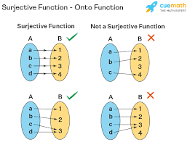
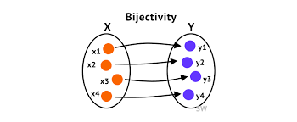
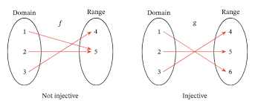
Injective/surjective/bijective
Injective: a function f is injective if no two distinct elements of Dom(f) are mapped onto one and the same member of Cod(f)
f(n) = n + 1
Surjective: a function f is surjective provided that every element of Cod(f) is the value of f for at least one element of Dom(f). Cod(f) = Image(f) f(w) = w^{R}
Bijective: a function that is both injective and surjective
Is the word reversal function bijective? Why (not)?
Is the constant-j function injective? Surjective? Bijective?

Slide 45
Polynomial Functions
Polynomial in n of degree k
a_{k}n^{k} + a_{k-1}n^{k-1} + a_{k-2}n^{k-2}+…+a₁n¹+a₀n⁰
k = natural number
a^{k} = coefficient: integer constant with a_{k}=0
2n⁵+2n³+4n²-16n+7
polynomial n of degree 5 with coefficients a₅=2, a₄=0, a₃=2, a₂=4, a₁=-16,a₀=7
2n^{5:} term of the highest degree
Definition of the function:
f: N→N
f(n) = 2n⁵+2n³+4n²-16n+7

Slide 46
Defining functions by recursion
Sum:
sum(n,0) = n
sum(n,m+1) = succ(sum(n,m))
Multiplication:
mult(n,0) = 0
mult(n,m+1) = n + mult(n,m) = sum(n,mult(n,m))
Trace these two functions with n=5

Slide 47
Graphs
Graph G = (V,E)
A pair consisting of a vertex/node set V and an edge/arc set E
V = {a,b,c,d,e}
E = {<a,c>,<c,d>,<d,e>,<e,c>,<c,b>,<b,a>}
a
d
c
b
e

Slide 48
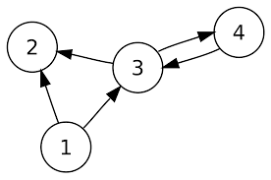
Terminology
Directed graphs (digraphs)
An edge <v,w> from vertex v to vertex w in digraph G is incident upon v and w. Vertex v is the tail of the edge and vertex w is head of the edge
w is the successor of v
Self-loop: tail = head

Slide 49
Terminology
A finite path within a digraph is a sequence of edges e₁e₂e₃…e_{n} such that for any two consecutive edges e_{k} and e_{k+1} with 1≤k<n the head of e_{k} is the tail of e_{k+1}
Length of a path = number of edges = n
If P = e₁e₂e₃…e_{n} and e =<v,w> is an edge within P, then P is said to traverse e and visit v and w

Slide 50
Terminology
Closed path within a digraph: finite path e₁e₂e₃…e_{n} such that the tail of e₁ is identical with the head of e_{n}
Cycle within a digraph: closed path where
No edge is retraversed
No vertex except the initial one is visited more than once
Initial vertex is visited exactly twice
Cyclic: subsequence of path P is a cycle
Acyclic: subsequence of path P is not a cycle

Slide 51
Terminology
Indegree of a vertex v within a digraph: number of distinct edges e such that v is the head of e
Outdegree of a vertex v within a digraph: number of distinct edges e such that v is the tail of e
Degree of vertex v is the sum of its indegree and outdegree
What is the degree of a self-loop on vertex v?

Slide 52
Terminology
Sink: vertex of outdegree 0 (ie no successors)
Source: vertex with indegree of 0
Identify sinks in Figure 0.7.3
b,e,c
Identify sources in Figure 0.7.3
f
What is the degree of d in Figure 0.7.3
4

Slide 53
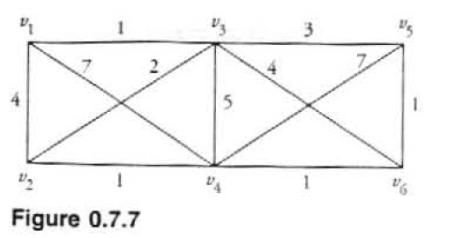
Weighted Graphs
Cost is assigned to edges in the graph
Cost of a path: sum of the weights assigned to the edges within that path
What is the cost of path v1v4v5v3v4
23
Find a least cost path from v1 to v6. Is it unique?

Slide 54
Proof Techniques
Conditional Proof
p→q
assume truth of the antecedent
reason to the truth of consequent q
If I drink too much alcohol, I can’t drive a car
When I drink alcohol, the alcohol gets absorbed in my blood. My blood reaches my brain, where it will distort its functionality, reducing my coordination abilities. To drive a car I need coordination.

Slide 55
Proof Techniques
Proof by contradiction
11 is not a prime number
if it is not a prime number, it must have a nontrivial factor. But it is not 2,3,4,5,6,7,8,9,10 and it can’t be larger than n. This is a contradiction, so 11 is a prime after all
Appropriate when p is unstructured. Then continue to prove that ¬p is true. Derive a contradiction of the form q & ¬q. Having assumed p is true, continue to show that q & ¬q is true. Conclude then that ¬p is not true, thereby showing p is true.

Slide 56
Conclusion

